Slide 1
Python Reinforcement:
Housing dataset
Neil Bestin, Nov, 13/05/2025

Slide 2
Introduction and insight to dataset
Problem statement and explanation of the project
This project requires any of the provided datasets to undergo a series of processes, including data cleaning, data visualisation, and 3 different dimensions of analysis, including univariate, bivariate, and multivariate analysis, using plots such as heatmaps and scatter plots to identify relationships
This is required for the housing dataset, in order to inform potential stakeholders of key features that are important in the business of real estate.
The housing dataset lists the various features that are highlighted when a house is listed in the market. However, due to the large amount of features, I have chosen few important features which include:
Price, bedrooms, bathrooms, sqft_lot, sqft_living, floors, condition, and yr_renovated.
These fields are the most common and the most important for a household

Slide 3
Housing Dataset
Description and important features
The Housing dataset contains the price, area of the lot and space used in terms of square feet, and important amenities such as bedrooms, bathrooms, and also other details such as the number of floors in the house. It also contains the date the data was added to the dataset, the country, state, and street address, as well as the zip code. It also contains data regarding any renovations made in the column “yr_renovated”
However, for the analysis of the dataset, only 8 features were most important: Price, Bedrooms, Bathrooms, sqft_lot, sqft_living, floors, condition, and yr_renovated, as from the 2nd feature onwards, they are the most important in influencing the first feature, price, and are the most important features in any household. The other features do not contribute much to the price of a property

Slide 4
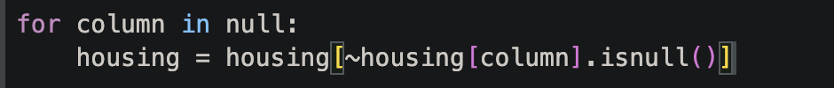
Data Cleaning
Importance of data cleaning, and steps taken towards it
Data cleaning is an essential process within data analysis, as this process removes any data that would tamper with any future analysis or machine learning model, as the data may include missing values, outliers, or incorrect data types.
Data cleaning ensures that any future analysis or model being used with said data will not incur any errors or will deviate from real-world data .
For this project, I used boolean indexing in order to remove missing values or outliers by grouping features that have data to be removed, and use the below format to remove them

Slide 5
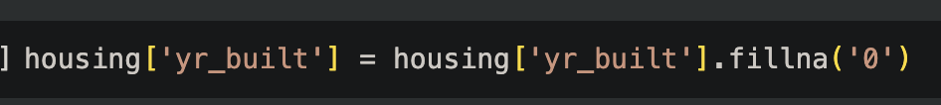
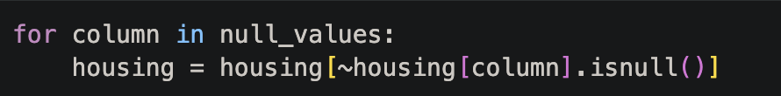
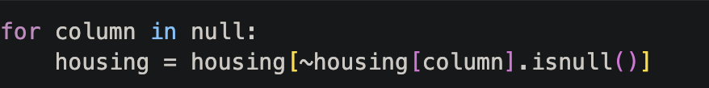
Handling missing values
Using boolean indexing, as well as fillna()
Out of 18 features, 4 features had null values. For the features sqft_lot, and sqft_living, I grouped them under the null_values array , and used boolean indexing to remove them.
The same is done for the city feature, where it was added to the null array and removed using the same.
For the yr_built column, empty values suggest that there is no information regarding when the house was built, hence I used the fillna() method to fill the null lanes with the value 0

Slide 6
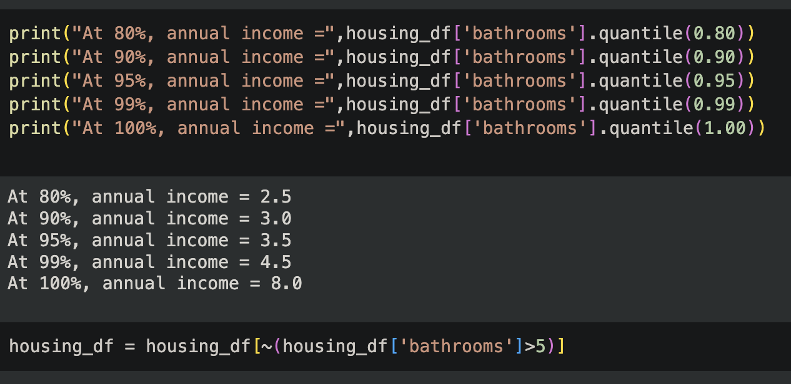
Outlier handling
Using boolean indexing to remove outliers
In order to find outliers, I used box and whisker plots for the features I would soon filter in order to decrease memory, as I would only have to remove the outliers for the most important features.
Using the quantile() method, and boolean indexing, was able to limit the values up to a certain limit, removing the outliers.

Slide 7
There was no handling of invalid values required

Slide 8
Statistical Analysis
Basic statistics and statistical tests
In order to numerically identify any major changes in the housing dataset, I used basic statistics such as mean, median, and quantiles in order to check for outliers, or identify any statistical test that can be used against the data.
For this project, I use hypothesis testing in order to determine If any of the features chosen through filtration show any difference in following a normal distribution

Slide 9
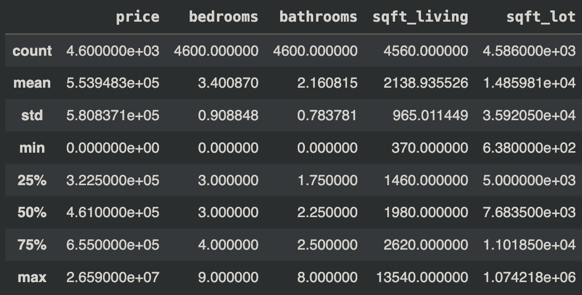
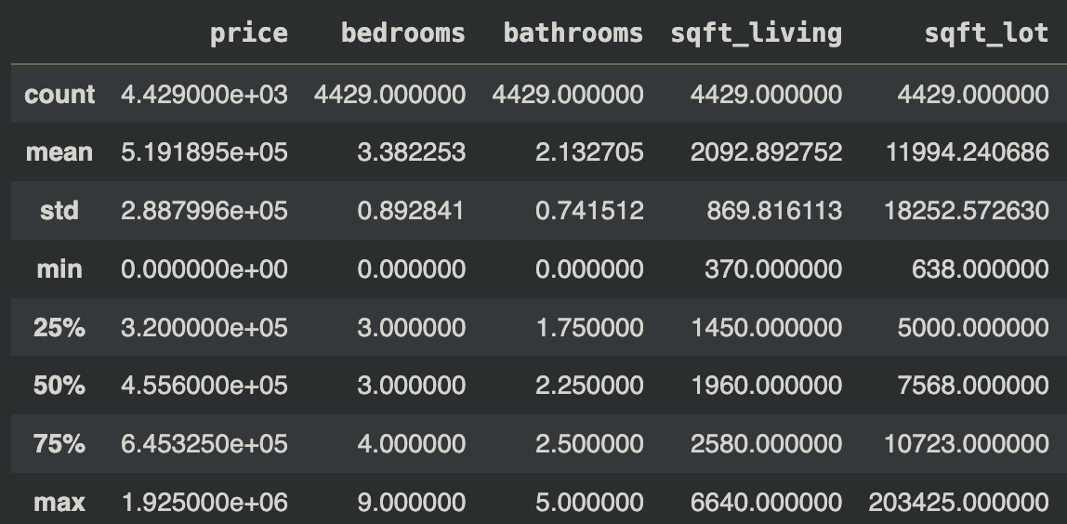
Descriptive Statistics
I used the describe() function in order to get basic statistics regarding the number of values in each column, as well as the mean, median, and the quantiles of 25% and 75%.
As seen on the right, the statistics of the first few columns have changed, due to the data cleaning process.

Slide 10
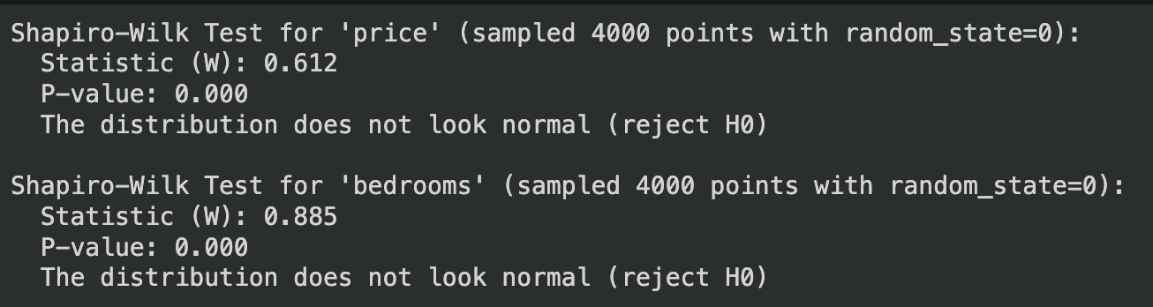
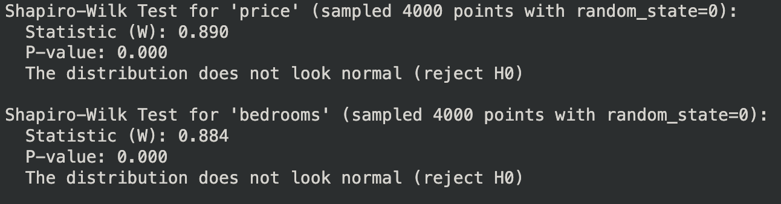
Key features chosen for analysis
Overview of chosen features as well as findings from Stat test
As mentioned earlier, out of the 18 features, only 8 were chosen to determine insights through analysis: price, bedrooms, bathrooms, sqft_lot, sqft_living, condition, and yr_renovated.
I used the Shapiro-wilk test for normality during the data cleaning process for outliers to determine whether any feature tends to behave as a normal distribution.
I determined that, though the coefficient changed, the p-values did not.

Slide 11
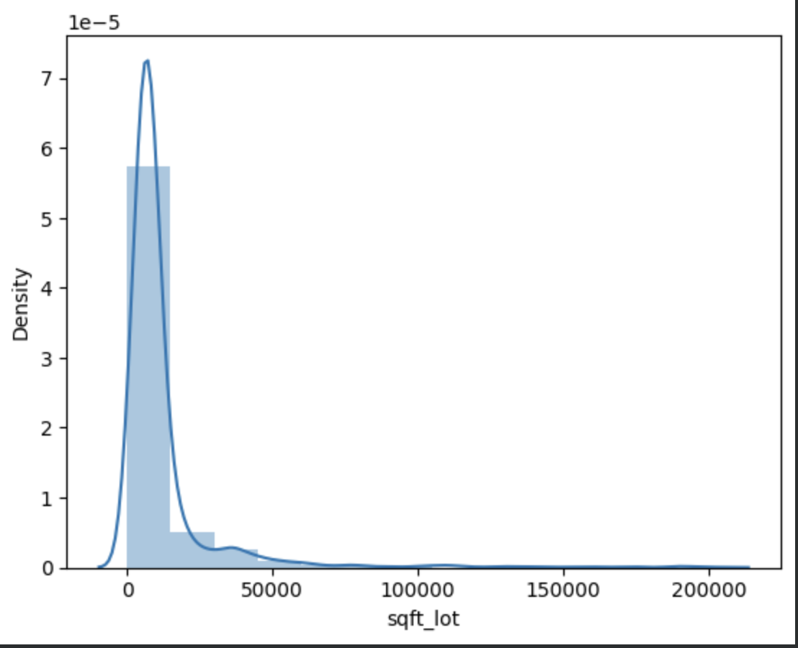
Introduction into Data visualisation
Importance of Data visualisation and types of plots used
Data visualisation is the easiest method of interpreting data, as it allows us to identify any outliers, trends, or distributions within the data.
For this project, I used a range of plots, including: histogram, displot, count plot, scatter plot, and bar plots combined with a kernel density function

Slide 12
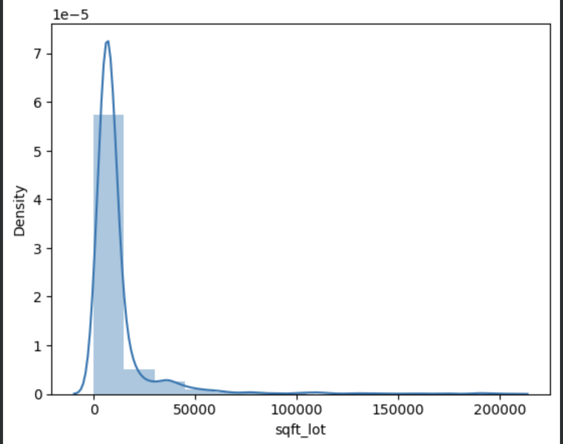
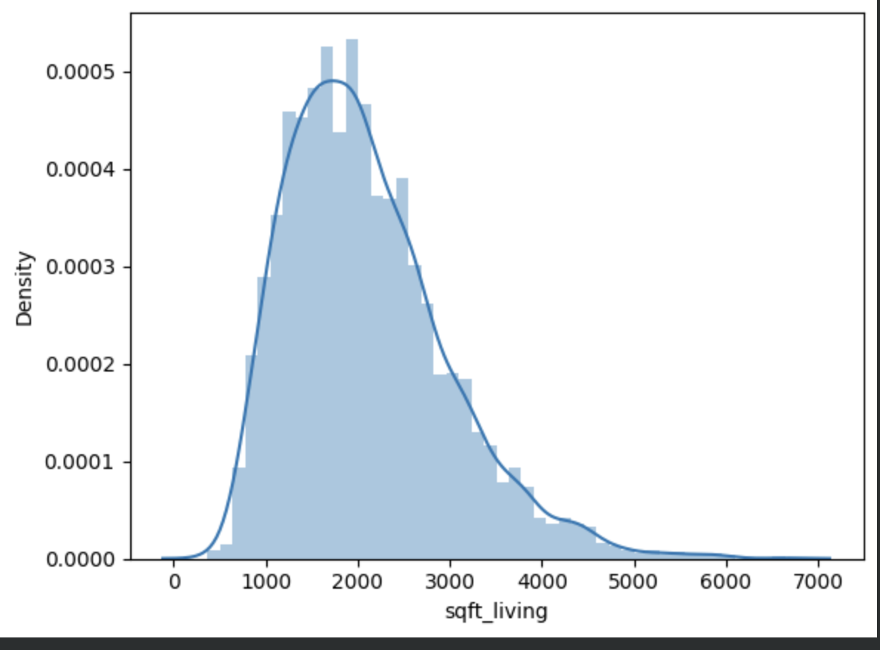
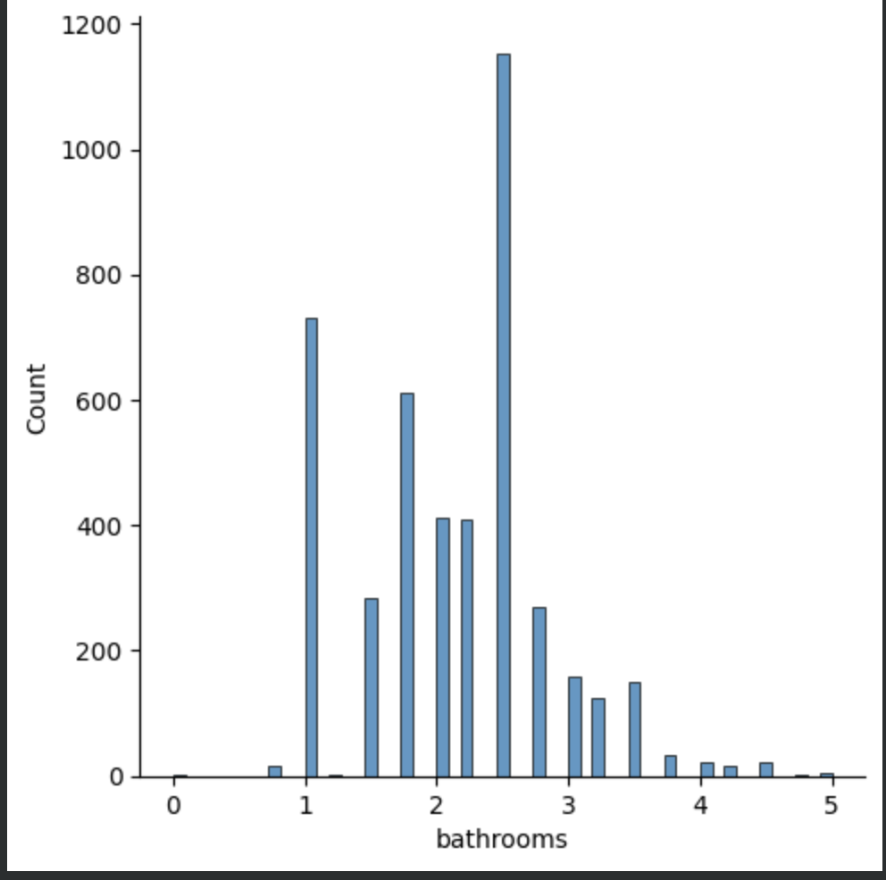
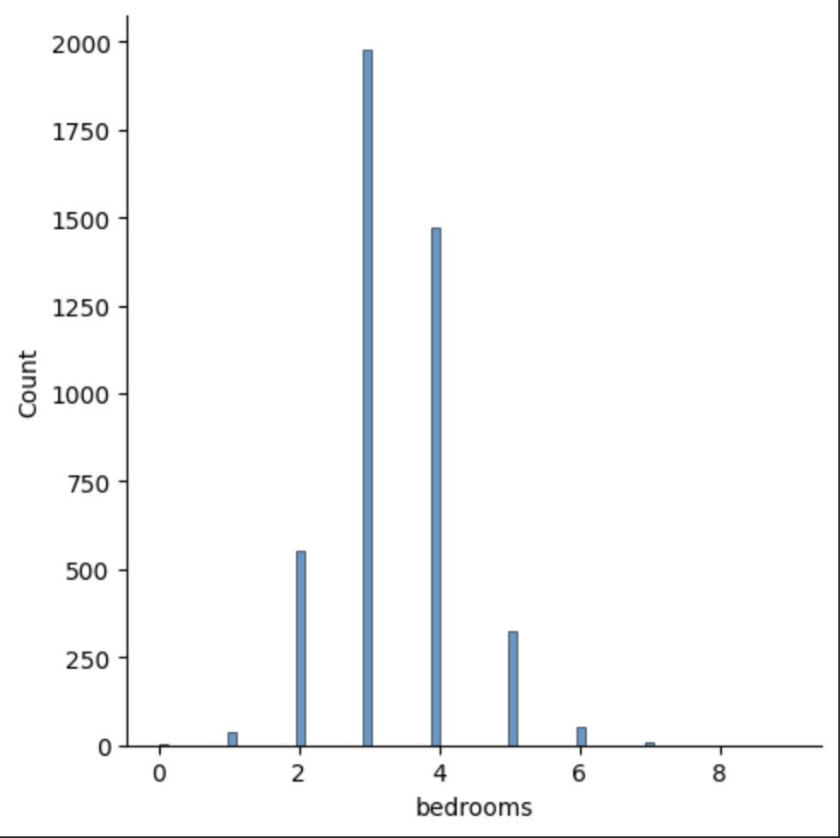
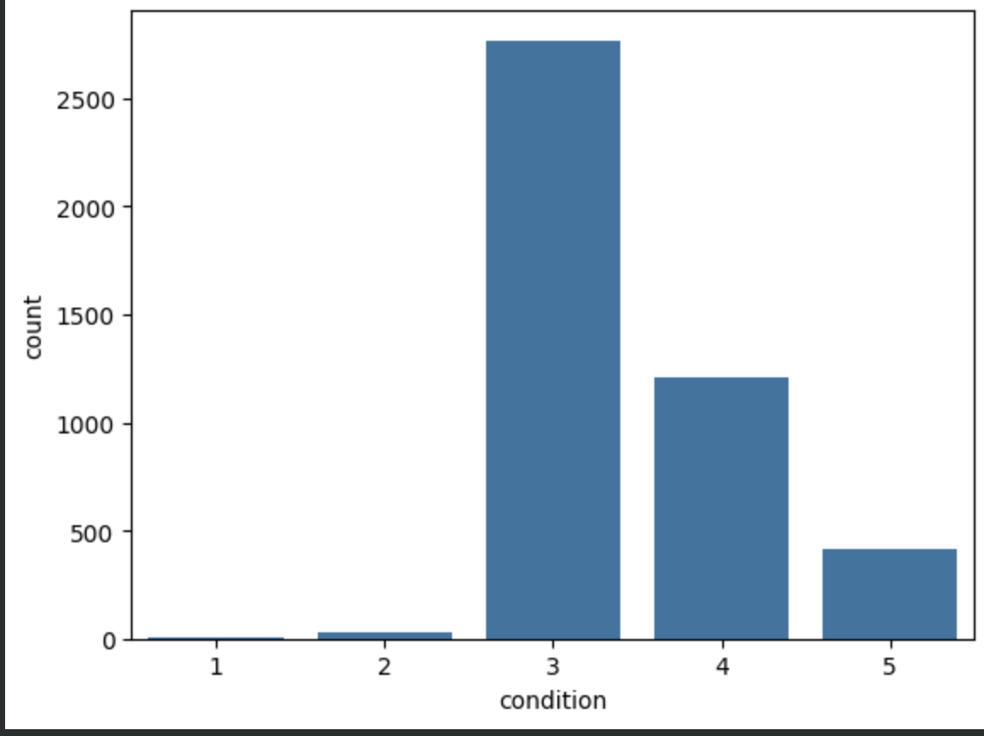
Univariate analysis
Plots used and interpretations of features
For the univariate analysis, I used plots in order to understand the behaviour of each feature, and which value or level is the most prominent

Slide 13
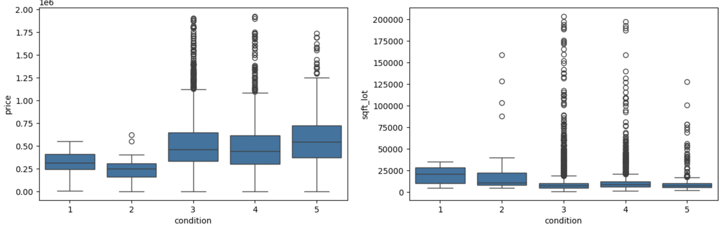
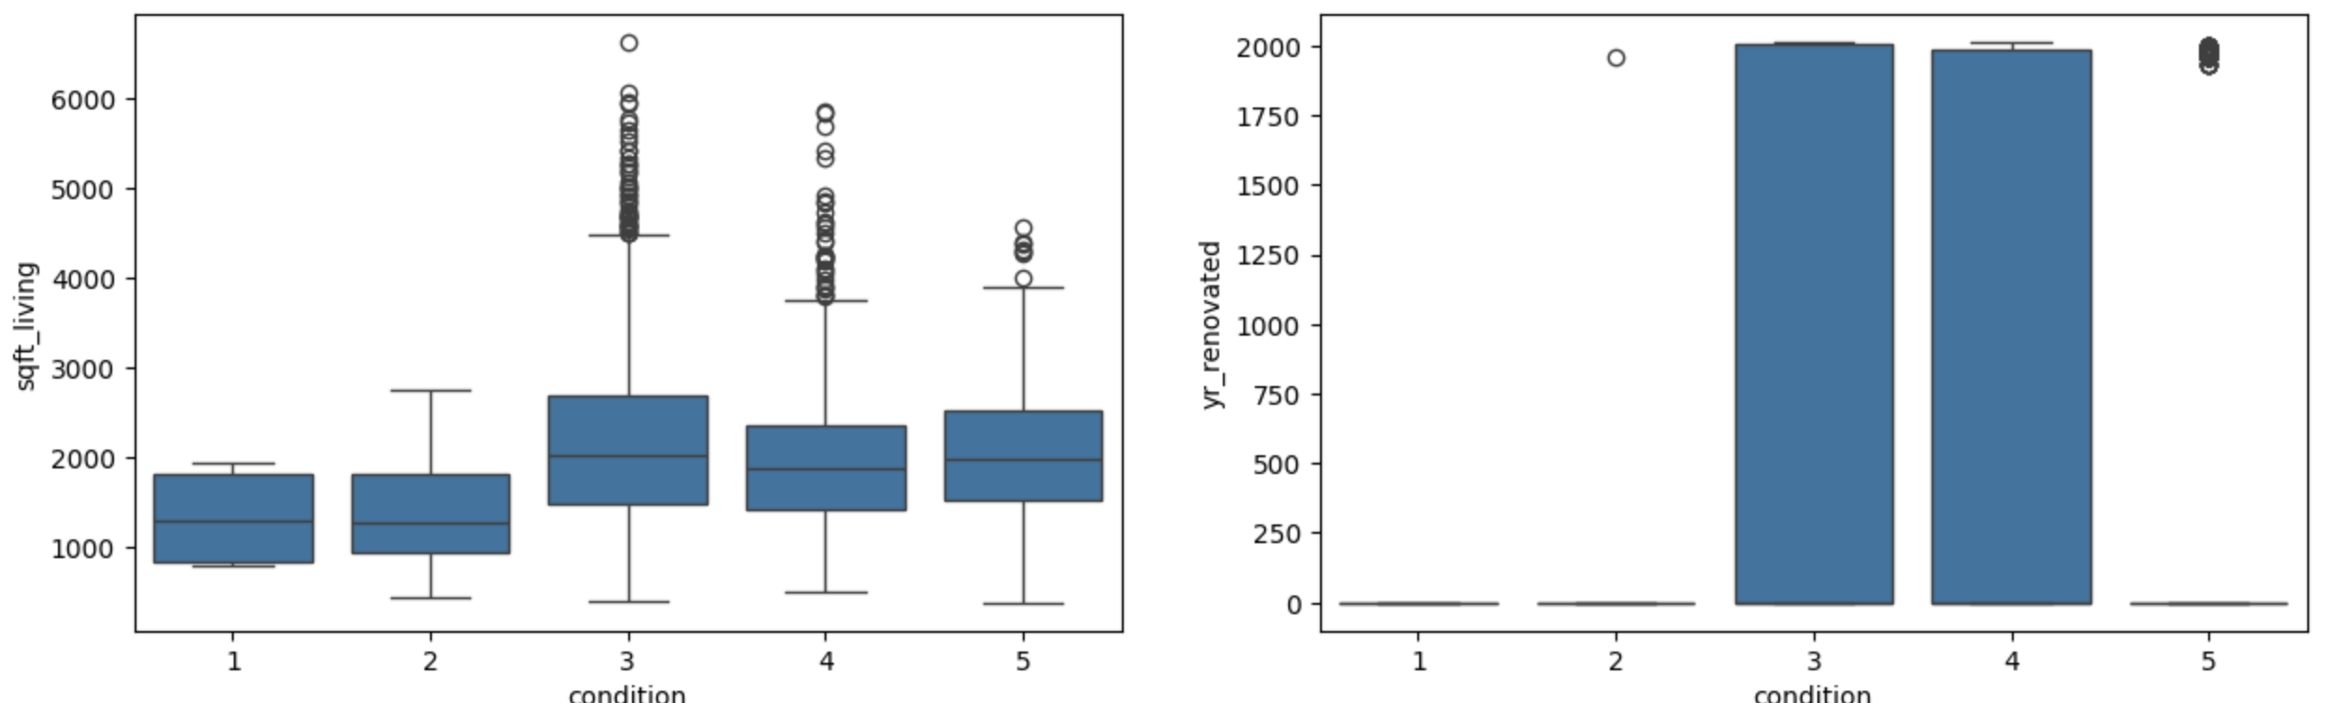
Bivariate analysis
Plots used and interpretations of features
For the bivariate analysis, I used bow and whisker plots, as well as histplot for price and condition.
For majority of the plots, I found the relationship of condition against price, sqft_lot, sqft_living, yr_renovated

Slide 14
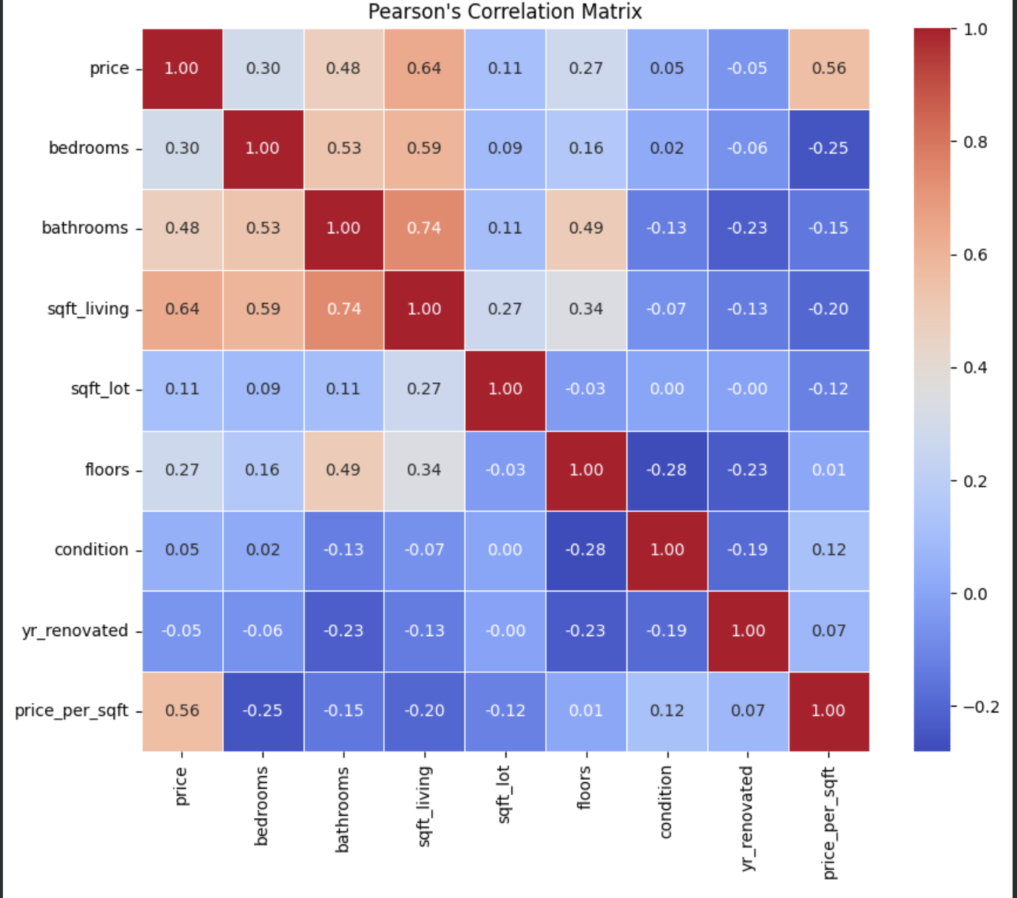
Multivariate Analysis
Plots used and interpretations of features
For the multivariate analysis, I used a combination of heat/correlation map along with correlation matrices calculated via Pearsons and spearman's correlation
From the multivariate analysis, I could identify that statistically, only 4 features have strong to relevant direct correlation with each other

Slide 15
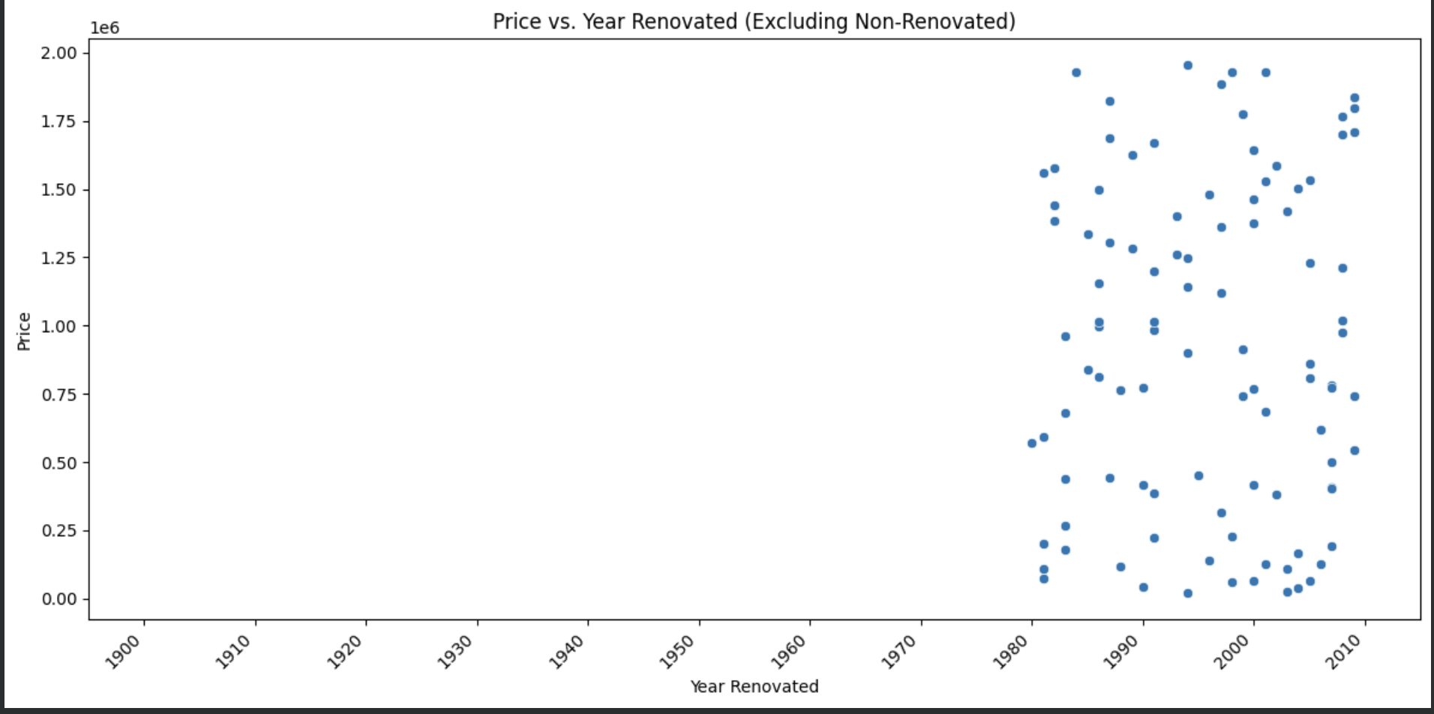
Conclusion
From the above analysis, I was able to find out that: only few features have direct correlation with each other
The price of a house, by itself, is dependent on other features, where the derived feature, price_per_sqft, is an important roll in determining the other features in a dataset during the building of a house
Key stakeholders must take into account that the analysis conducted only assumes a direct relationship, when in fact, it is not
The following plot provides guidance on how the relationships between all 9 features might work

